Slide 1



R as a statistical tool
S.Mohan Kumar

Slide 2
Contents
What is Statistics
Types of statistics
What are Descriptive statistics
Frequency tables and graphs, Histograms
Central Tendency
Mean, Median, Mode
Dispersion
Range, variance, standard deviation
Quartiles, Percentiles
Box Plots
Bivariate Descriptive Statistics
  Correlation

Slide 3
Statistics
It is the science of collecting, organizing,analyzing and interpreting data
Statisctics is broadly classified into two types:
  Descriptive
  Inferential

Slide 4
Some terms
Population - total amount of things
Sample – a part of the population
Variables – eg. Height, weight, age
Two types:
  Quantitative – can be quantified
    eg. height, weight
    Quantitative are further classified into
      Discrete – eg. No. Of people – 1,2,3
      Continues – eg. Height – 150.5cms. 173.45 cms
  Categorical – descriptive
    eg. hair color, gender
    They are further classified into
      Ordinal – has some kind of order eg. A+, A, B
      Nominal – no logical order possible eg. Haircolor

Slide 5
Some terms...contd
Data set - all the data collected in a particular study
Elements – entity on which data is collected
Observation – each individual measurement of the variables. eg. Height = 160cm , weight= 65kgs
Types of data
  Cross sectional data – collected one time
  Time series data – data collected at periodic intervals eg. Stock price on a daily basis.
  Sources of Data:
    Primary data – data collected directly for a study
    Secondary data – data already existing
      eg.https://data.gov.in/
  Data warehousing – the process of collecting,storing and maintaining data
  Data Mining – The process of extracting information and uncovering patterns.

Slide 6
Descriptive statistics
Used to describe the data set. A statistic or a measure that describes the data
  Average sales
  Permit the analyst to describe many pieces of data with a few indices
Descriptive statistics tell us what happened in the past.
Descriptive statistics avoid inferences but, they help us to get a feel of the data.
Some times they are good enough to make an inference.
Describing data with tables and graphs (quantitative or categorical variables)

Slide 7
Simple Descriptive Statistics
N
Sum
Min
Max
Average
Frequency of each level
Variance
Standard deviation
These simple descriptive statistics will be used in inferential statistics later.

Slide 8
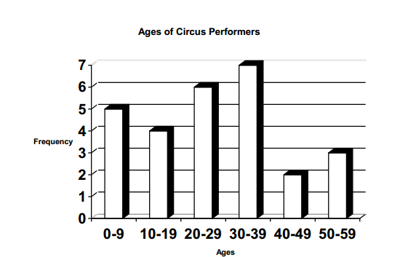
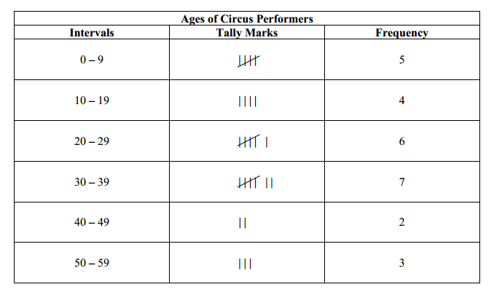
Frequency tables & Histograms
Frequency distribution: Lists possible values of variable and number of times each occurs

Slide 9
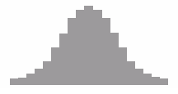
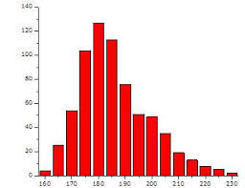
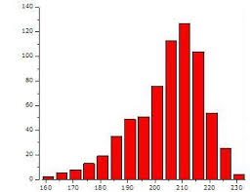
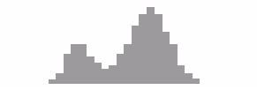
Shapes of histograms
Bell-shaped (IQ, SAT scores, political ideology in all U.S. )
Skewed right
  Example Annual income
  No. times arrested
Skewed left
  Score in easy exam
Bimodal
  Hardworking days in a year (Peaks near Mid year & year end Appraisal)

Slide 10
Central tendency
What is the typical age of the patients?
What is the usual claim amount per patient?
What is central tendency? - Average
Three types of Averages
  Mean
  Median
  Mode

Slide 11
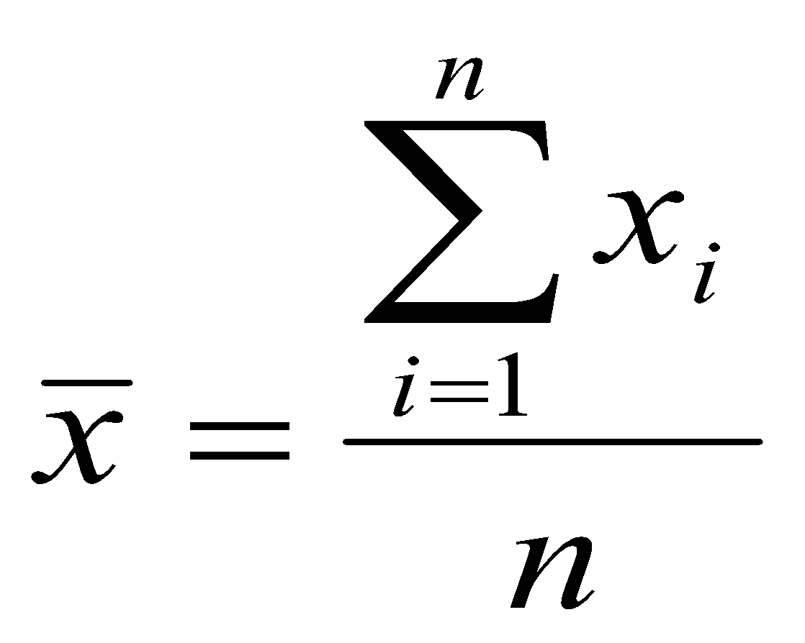
Mean
Center of gravity
Evenly partitions the sum of all measurement among all cases; average of all measures
Crucial for inferential statistics
Mean is not very resistant to outliers –See in Median

Slide 12
Median
Median is exactly in the middle.
Order the observations in ascending or descending order and pick the middle observation
less useful for inferential purposes
More resistant to effects of outliers…

Slide 13
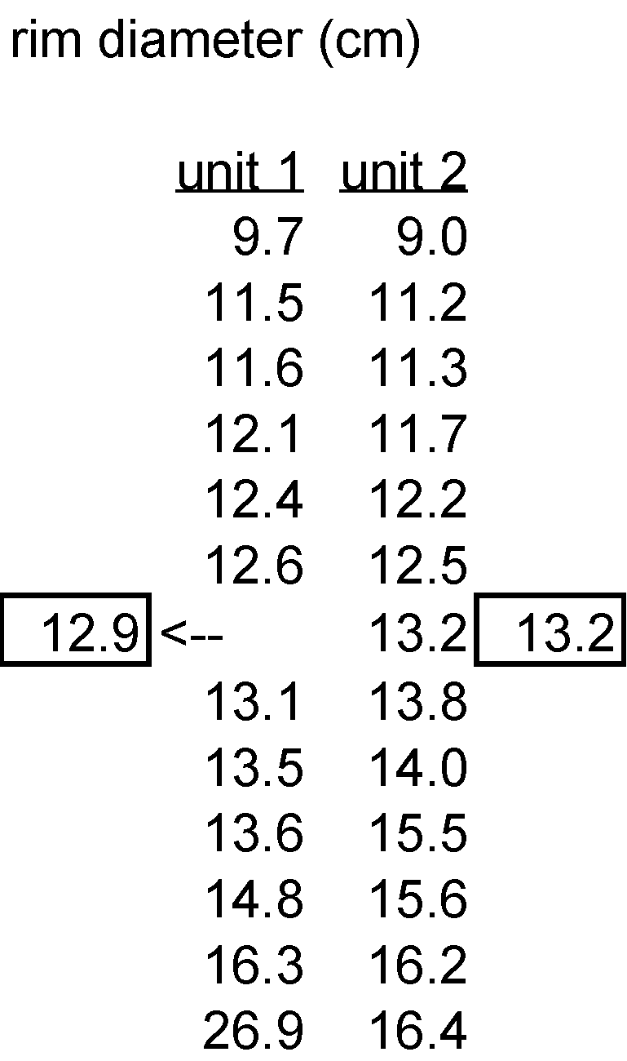
Calculation of Median

Slide 14
Mode
How do you express average size of the shoes ?
  6.567 or 6?
Average number of kids for an American couple
  1.8768 or 2?
  1,2,3,3,3,4,5
Mode is the most numerous category – in above data set it is 3
Can be more or less created by the grouping procedure
For theoretical distributions—simply the location of the peak on the frequency distribution

Slide 15
Dispersion
Person1: What is the average depth of this river? 5 feet
Person2: I am 5.5 I can easily cross it(and starts crossing it)
Person 2: Help….help.
Person 1: Some times just knowing the central tendency is not sufficient
Measures of dispersion summarize the degree of clustering/spread of cases, esp. with respect to central tendency…
  range
  variance
  standard deviation

Slide 16
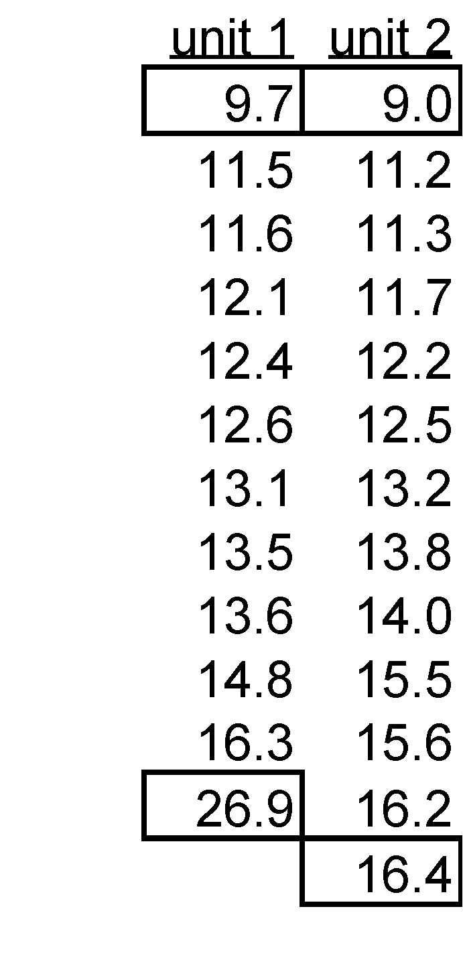
Range
Max –Min
R: range(x)

Slide 17
Variance
Here is month on month sales data
295 289 300 289 292 298 291 286 283 290 287 295 297 299 281 285 289
What is the variation in sales?
Lets take base as mean….Variation from mean…Average variation from mean

Slide 18
Why standard deviation?
Units of variance are squared… this makes variance hard to interpret
Eg : Mean length of bolt= 22.6 mm variance = 38 mm²
Average sales is 290.9 dollars and variance in sales is 30$²
What does this mean??? –I don’t Know

Slide 19
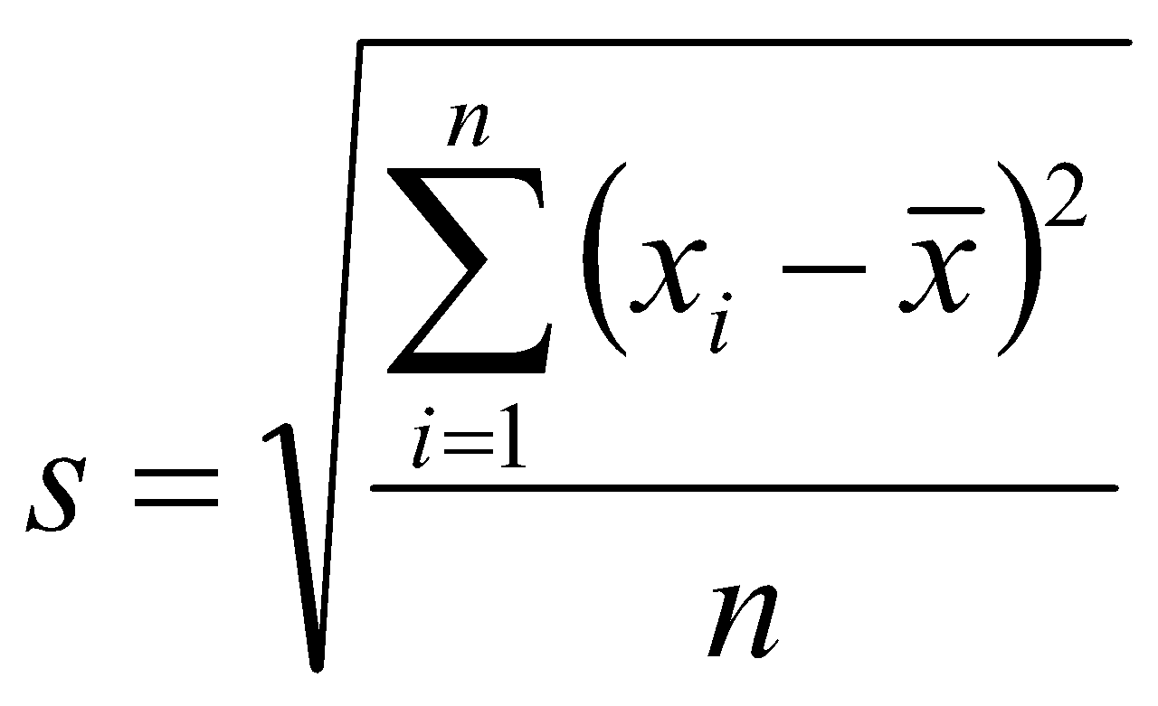
Standard Deviation
Square root of variance
Units are in same units as base measurements
Mean = 22.6 mm standard deviation = 6.2 mm
Mean +/- sd (16.4—28.8 mm)
  should give at least some intuitive sense of where most of the cases lie, barring major effects of outliers

Slide 20
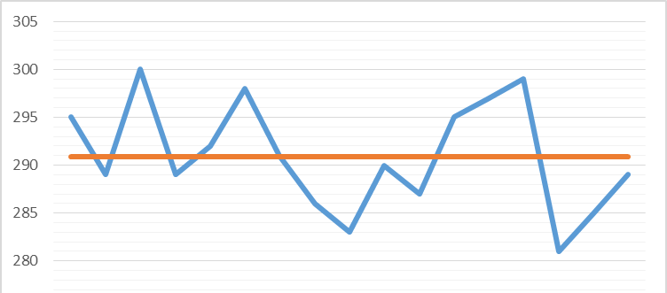
Standard Deviation
Average sales is 290.9 dollars and standard deviation is 5.5$

Slide 21
Quartiles & Percentiles
pth percentile: p percent of observations below it, (100 - p)% above it.
Like 95% of CAT exam percentile means→ 5% are above & 95% are below
1,2,3,4,5,6,7,8,9,10 - What is 25th percentile?
1,2,3,4,5,6,7,8,9,10,11,12,13,14,15,16,17,18,19,20 - What is 25th percentile? What is 80th percentile?
  p = 50: median : second quartile
  p = 25: lower quartile (LQ)
  p = 75: upper quartile (UQ)
Interquartile range IQR = UQ - LQ

Slide 22
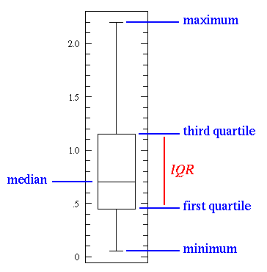
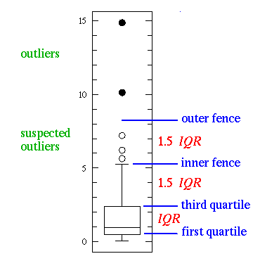
Box Plots
Quartiles portrayed graphically by box plots
Helps us to identify the outliers easily

Slide 23
Correlation
Correlation describes strength of association between two variables
Falls between -1 and +1, with sign indicating direction of association (formula & other details later )
The larger the correlation in absolute value, the stronger the association (in terms of a straight line trend)
Examples: (positive or negative, how strong?)
  Mental impairment and life events
  GDP and fertility
  GDP and percent using Internet

Slide 24
What is need of correlation?
Is there any association between hours of study and grades?
Is there any association between number of church building in a city & number of murders?
What happens to sweater sales with increase in temperature? What is the strength of association between them?
What happens to ice-cream sales v.s temperature? What is the strength of association between them?
  How to quantify the association?
  Which of the above examples has very strong association?
  Correlation

Slide 25
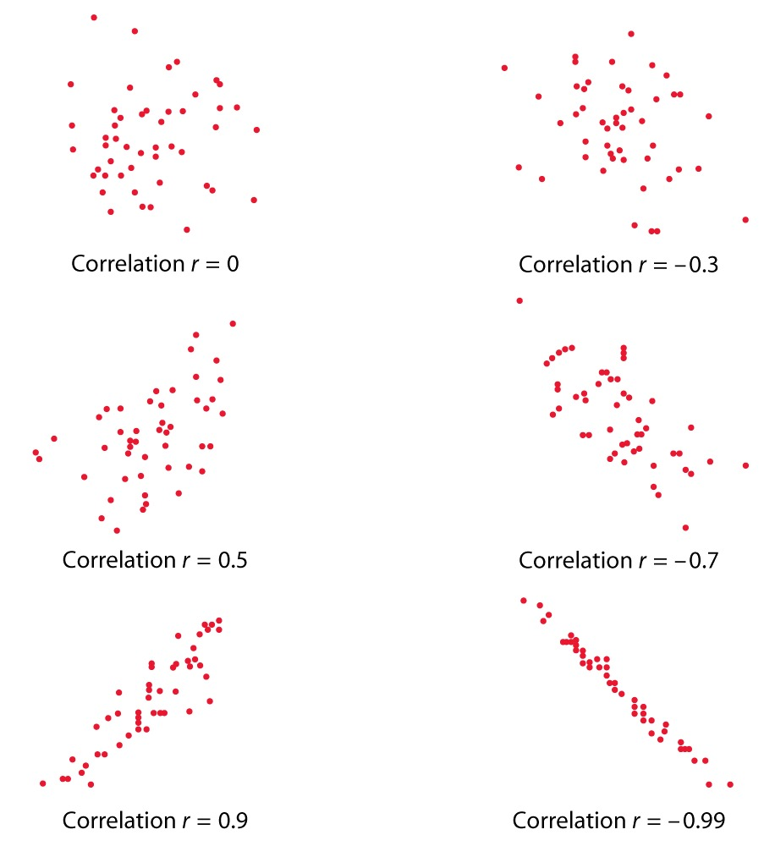
Strength of Association
Correlation 0 →No linear association
Correlation 0 to 0.25 →Negligible positive association
Correlation 0.25-0.5 → Weak positive association
Correlation 0.5-0.75 →Moderate positive association
Correlation >0.75 →Very Strong positive association
What are the limits for negative correlation

Slide 26
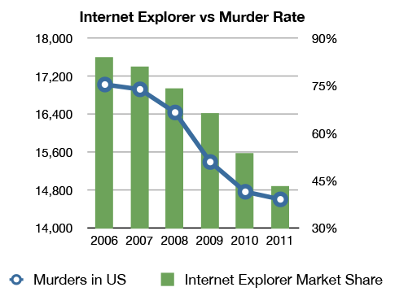
Correlation does not mean Causation
Data Analysis Course Venkat Reddy

Slide 27
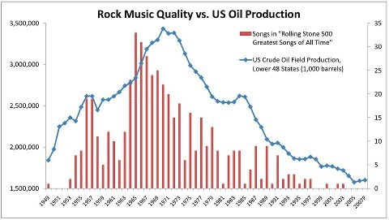
Correlation vs. Causation
Data Analysis Course Venkat Reddy
Correlation is a mathematical formula. You will get a number no matter what data you feed.
Having a correlation doesn’t imply that you also have causation
First you need to establish a logical relation and then find the correlation

